Slide 1
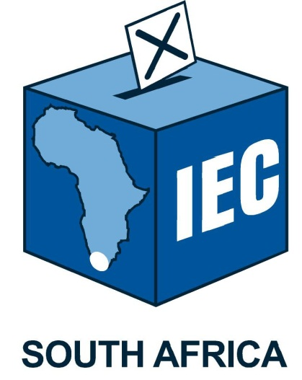
ELECTORAL COMMISSION OF SOUTH AFRICA
Political Party Funding

Slide 2
Political Party Funding
Act 6 of 2018

Slide 3
Contents
High level overview of the Act
Interpretation, funds and section by section summary of the Act
Schedules
Implementation progress
Definition, Background and Purpose
Current Status and Issues & SWOT Analysis

Slide 4
High level overview
Foundational values of the Constitution
  Accountability
  Openness in a multi-party democracy
It is important to
  Deepen democracy
  Promote national interest
  Protect the sovereignty of the Republic
Effect is given to this by
  Establishing additional fund to receive funds from private sources subject to certain restrictions
  Prohibiting certain donations made directly to political parties
  Providing on how donations are disclosed

Slide 5
High level overview
Section 236 of the Constitution requires national legislation to enhance multi-party democracy by funding
  Political parties participating in national and provincial legislatures
  On an equitable and proportional basis
The outlawed Public Funding of Represented Political Parties Act 103 of 1997 gave effect to section 236
  Established the Represented Political Party Fund
  Commission administers the Represented Political Party Fund
  Allocation to represented political parties: 90% proportional and 10% equitable (Revised to 2/3 proportional and 1/3 equitable)

Slide 6
High level overview – Cont’d
Two Funds
  Act retains the repealed Represented Political Party Fund(RPPF) which is funded from public money
  Act establishes a new fund, the Multi-Party Democracy Fund(MPDF) which is funded from private sources
Administration of the Funds
  Commission administers the Funds
  Most of the provisions regulating the funds are drawn from the repealed Public Funding of Represented Political Parties Act.
Act regulates direct private donations to political parties.

Slide 7
High level overview – Cont’d
It prohibits direct political party donations from:
  Foreign governments and foreign government agencies
    Except in respect of donations from foreign entities for the purpose of training, skills development or policy development (limited to R5m per financial year)
  Organs of state
  State owned enterprises
  Proceeds of crime ito POCA
It prohibits contributions to MPDF from:
  Foreign governments and foreign government agencies
  Organs of state
  State owned enterprises
It places a cap on how much any person or entity can donate in a year.
It prohibits donations made to a member of a party, except if the donation is for political party activity and accepted on behalf of the party.
Contributor to MPDF may request anonymity, i.e. identity or amount of contribution

Slide 8
High level overview – Cont’d
Act requires the disclosure of all donations above a prescribed threshold to the Commission by:
  The political party]
  The donor]
The Commission must publish the donations disclosed to it on a quarterly basis.
The Act provides that these disclosure requirements do not detract from the right to access to information under the Amended Promotion of Access to Information Act(PAIA).
Donations above R100 000 must be disclosed by both the donor and the party, maximum donation is capped at R15m per financial year.

Slide 9
High level overview – Cont’d
Duties of political parties
  The Act imposes accounting and reporting obligations
  The Act provides for unspent money from the Funds at the end of the financial year and if a legislature is dissolved or its term expired.
Enforcement
  The Act gives the Commission:
    Monitoring and inspection powers
    Powers to suspend payments of money and recover money irregularly received or spent.
    The Act gives the Electoral Court the power to review decisions of the Commission and to impose administrative fines.

Slide 10
Interpretation and Funds
Chapter 1 (Interpretation)
Consists of the definitions of the Act (sec.1)
Chapter 2 (Funds)
Establishment of the Represented Political Party Fund (sec.2)
Establishment of Multi-Party Democracy Fund (sec.3)
Investment of money in Funds (sec.4)
Management and administration of Funds (sec.5)
The allocation and payment of money to represented political parties(sec.6)
The purposes for which the money from the Funds may be used (sec.7)

Slide 11
Direct funding of political parties
Chapter 3 (Direct funding of political parties)
Prohibited donations (sec.8)
Disclosure of donations to political parties (sec.9)
Prohibition of donations to a member of a political party(sec.10)

Slide 12
Duties of political parties
Chapter 4 (Duties of Political Parties)
Political parties to furnish information to the Commission at prescribed times(sec.11)
How political parties must account for its income (sec.12)
Unspent money at the end of a financial year (sec.13)

Slide 13
Enforcement
Chapter 5 (Enforcement)
Commission’s monitoring and inspection powers(sec.14)
Commission’s power to issue directions(sec.15)
Power to suspend payment of money to political parties (sec.16)
Power to recover money irregularly accepted or spent(sec.17)
Administrative fines (sec.18)
Offences and penalties (sec.19)
Reviews and appeals (sec.20)

Slide 14
General provisions
Chapter 6 (General Provisions)
Administration of the Funds within the Commission(sec.21)
Commission reporting to Parliament(sec.22)
Funding of represented political parties by legislatures(sec.23)
Regulations(sec.24)
Repeal and transitional provisions(sec.25)
Short title – Political Party Funding Act, 2018(sec.26)

Slide 15
Schedules1 and 2
Schedule 1
Maximum permissible fines that the Commission may impose for contravening the Act.
Schedule 2
Regulations on Political Party Funding(Presidential regulations)

Slide 16
Implementation progress
Developed an online party funding system
Finalized and gazetted the regulations germane to the implementation of the Act
Trained the political parties’ accounting officers on-site
Trained political parties represented at provincial and municipal level
Trained registered unrepresented political parties
Presented to representatives of all provincial legislatures
Met with various business chambers to publicize the new Fund, MPDF.
Continuous interaction and presentations to other stakeholders
Some political parties and direct donors have already started capturing declarations on the OPFS

Slide 17

Thank You

